Slide 1
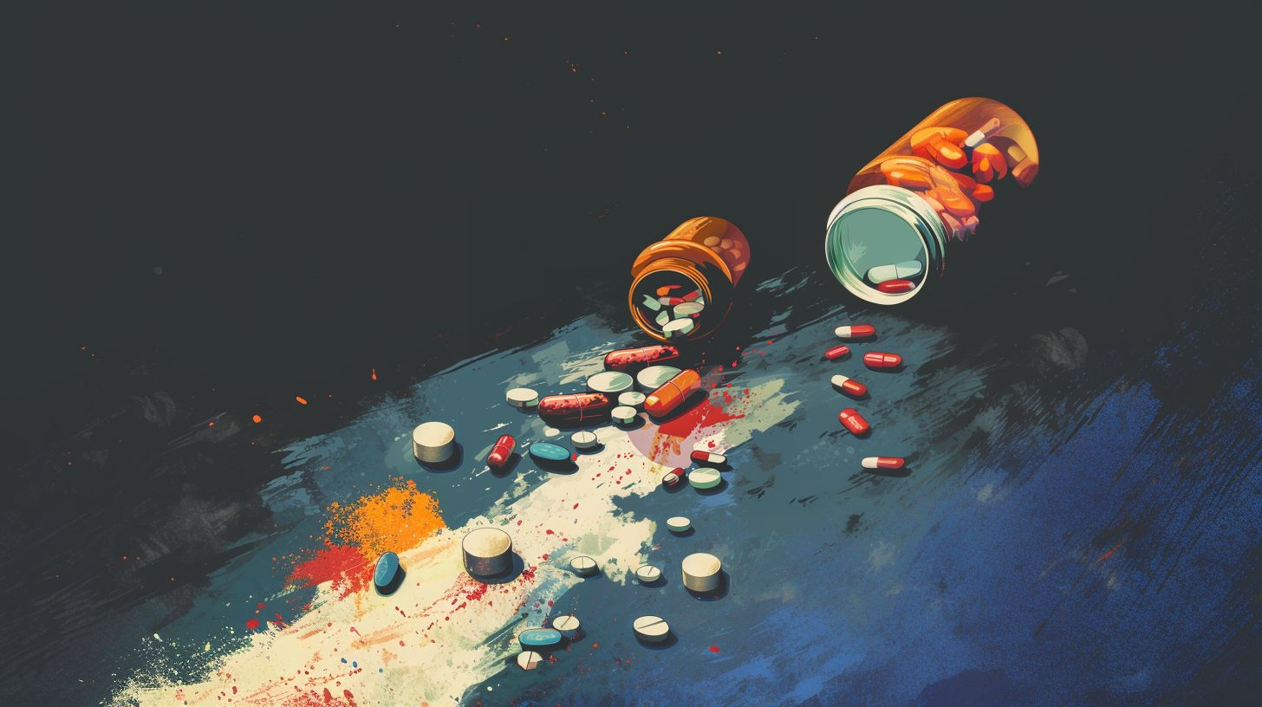
عُبُور
OBOUR
G04
Reema Hesamudin - 2106126
Alaa Asghar - 2105843
Bakerah Alseari -2107854

Slide 2



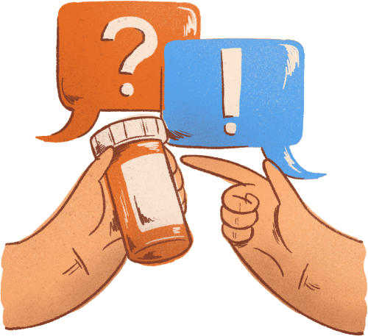
OBOUR
عُبُور
OUTLINE
01
INTRODUCTION
05
TESTING
08
FUTURE WORK
02
SOLUTION EFFECTIVENESS
06
PROJECT RESULTS
CONCLUSION
09
03
FEATURES
07
PROJECT LIMITATIONS
04
DESIGN OF THE SYSTEM

Slide 3

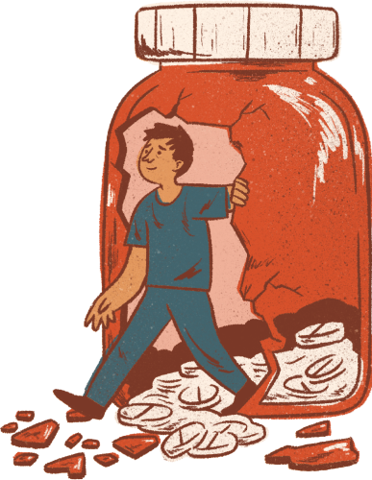
OBOUR
عُبُور
INTRODUCTION

Slide 4
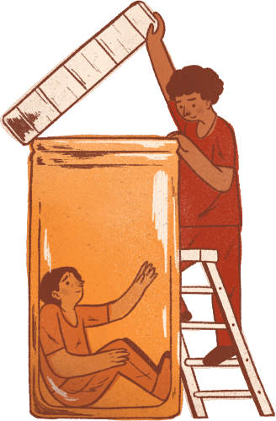
OBOUR
عُبُور
SOLUTION EFFECTIVENESS

Slide 5
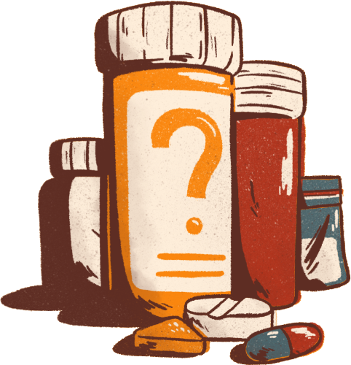
OBOUR
عُبُور
PROBLEM DEFINITION
POST-REHABILITATION PATIENTS:
Experience problems with all body functions, including memory disruptions that cause forgetfulness, as well as psychological issues such as depression, anxiety, and stress.
Struggle with relapse after recovery.
Lack society support through his/her recovery plan.
Are Arabic speakers and searches for an app that compline with its language and beliefs.
May have limited awareness of substance use.

Slide 6

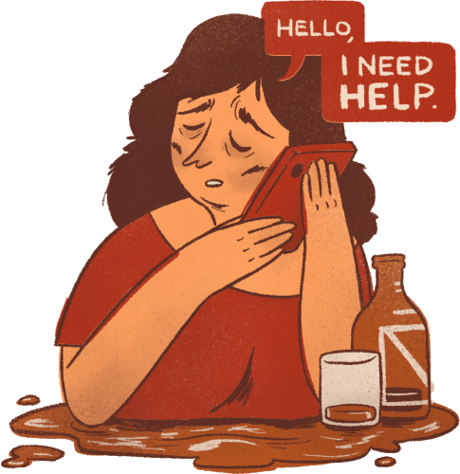
OBOUR
عُبُور
AIMS & OBJECTIVES
Developing strategies for more personalized and effective behavioral treatment approaches
Encouragement for continued recovery
Improvement in long-term success and societal reintegration
Enhancing motivation and self-esteem by acknowledging patients' efforts and achievements
Post-rehabilitation patients
Obour | عُبُور

Slide 7
OBOUR
عُبُور
AIMS & OBJECTIVES
Providing emotional support to help patients maintain hope during recovery
Building a support network that helps patients reach out for help and feel less isolated
Awareness raising about substance use disorder in society
Post-rehabilitation patients
Obour | عُبُور

Slide 8


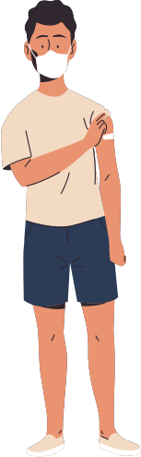











OBOUR
عُبُور
SUGGESTED SOLUTION
Remainder for Activities
The patient enter their credentials
Supportive Quotes Afformation
OBOUR APP
The patient enters their preferred activities
تطبيق عُبُور
System
Post-rehabilitation patient
Educational information about substances (YT, Podcasts, Articles, etc)
The patient enters their emotional state for the day
Customized weekly Activity plan
Achievement badges
Connect with peers through SMS msg

Slide 9
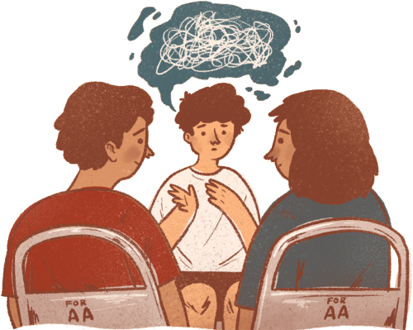
OBOUR
عُبُور
FEATURES

Slide 10
OBOUR
عُبُور
FEATURES
Customized weekly Activity plan
Supportive quotes based on patients' emotion and type of preferred qoutes
Achievement badges
Educational information about substances (YT, Podcasts, Articles, etc)
Connect with peers through SMS msg
Notification remainder for Activities

Slide 11
OBOUR
عُبُور
SYSTEM DESIGN

Slide 12
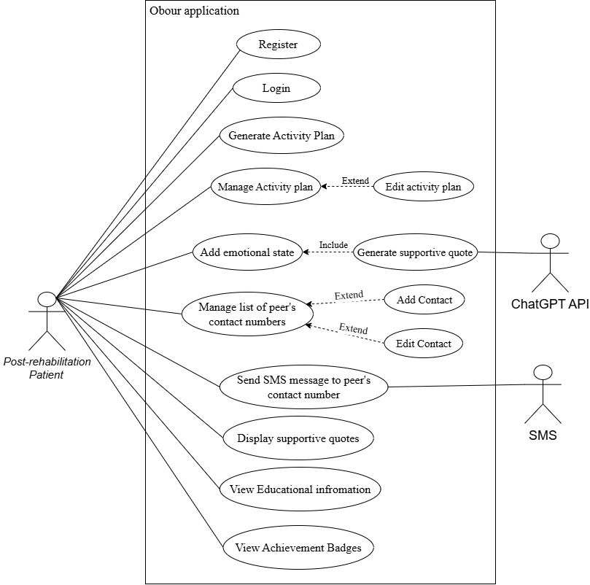
OBOUR
عُبُور
DESIGN OF THE SYSTEM
USE CASE

Slide 13
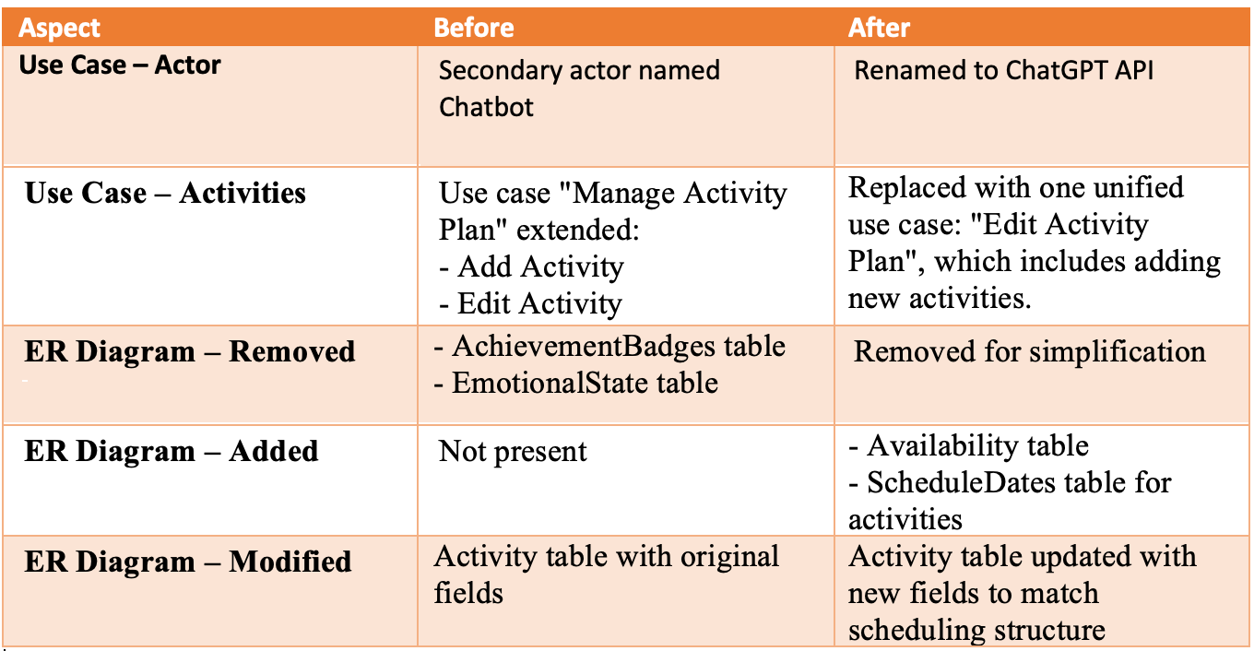
OBOUR
عُبُور
DESIGN OF THE SYSTEM
CHANGES FROM OLD USE CASE

Slide 14
OBOUR
عُبُور
DESIGN OF THE SYSTEM
CLASS DIGRAM

Slide 15
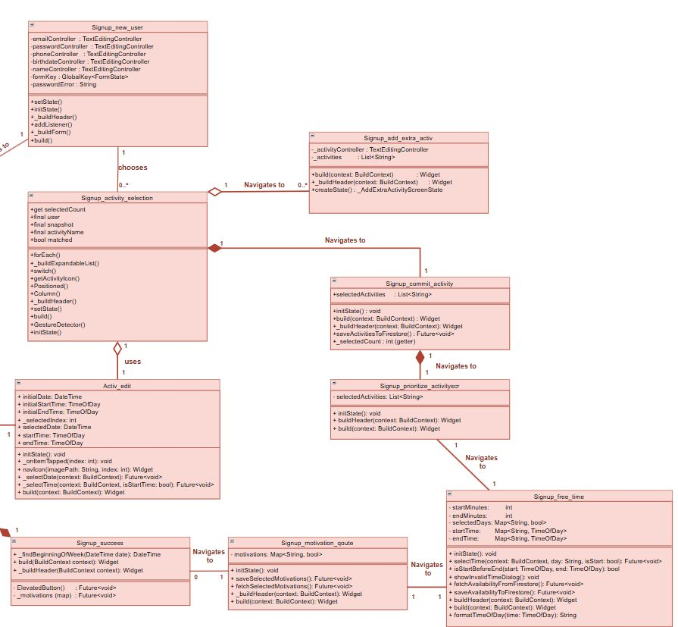
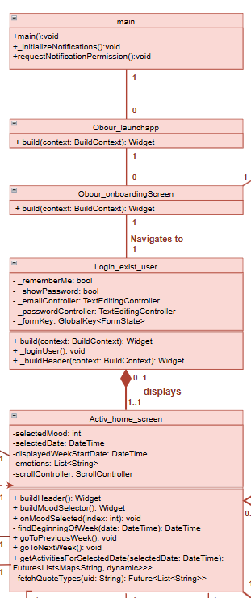
OBOUR
عُبُور
CLASS DIGRAM
LOG IN / SIGN UP

Slide 16
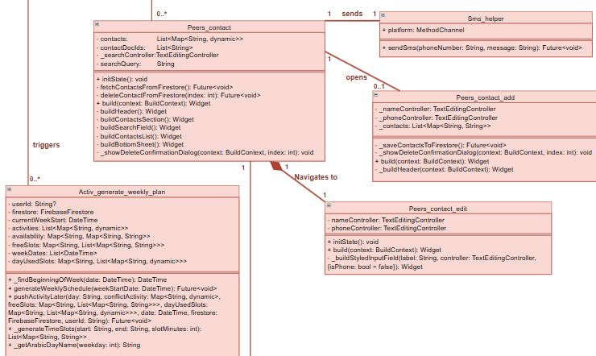
OBOUR
عُبُور
CLASS DIGRAM
PEER CONTACT

Slide 17
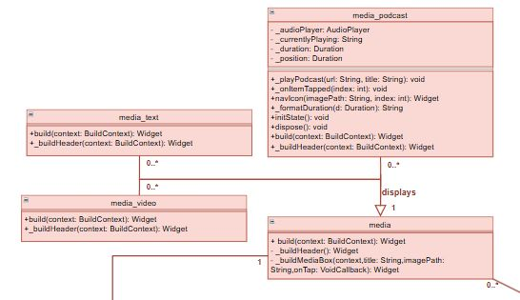
OBOUR
عُبُور
CLASS DIGRAM
MEDIA

Slide 18
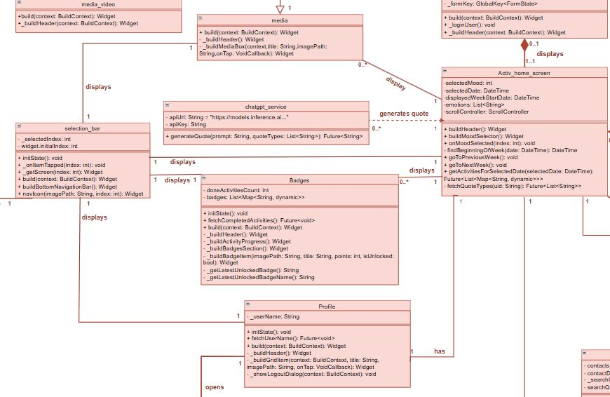
OBOUR
عُبُور
CLASS DIGRAM
BADGES / PROFILE

Slide 19
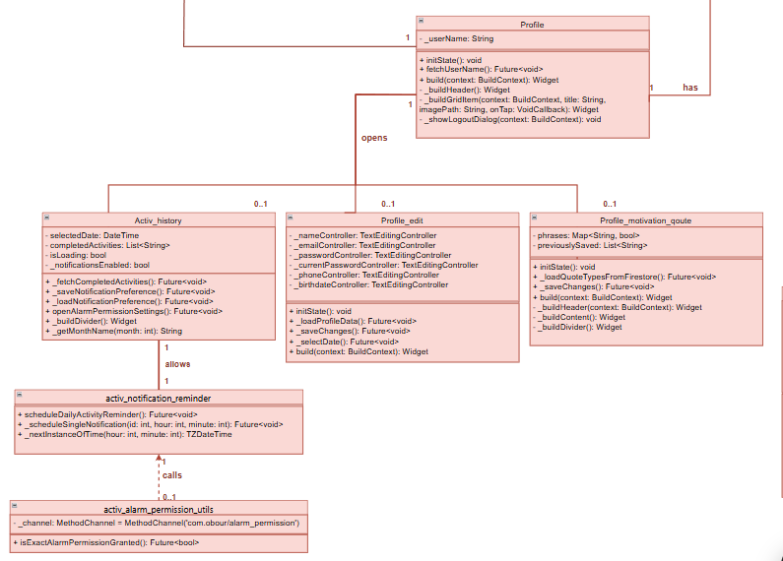
OBOUR
عُبُور
CLASS DIGRAM
PROFILE / NOTIFICATION

Slide 20
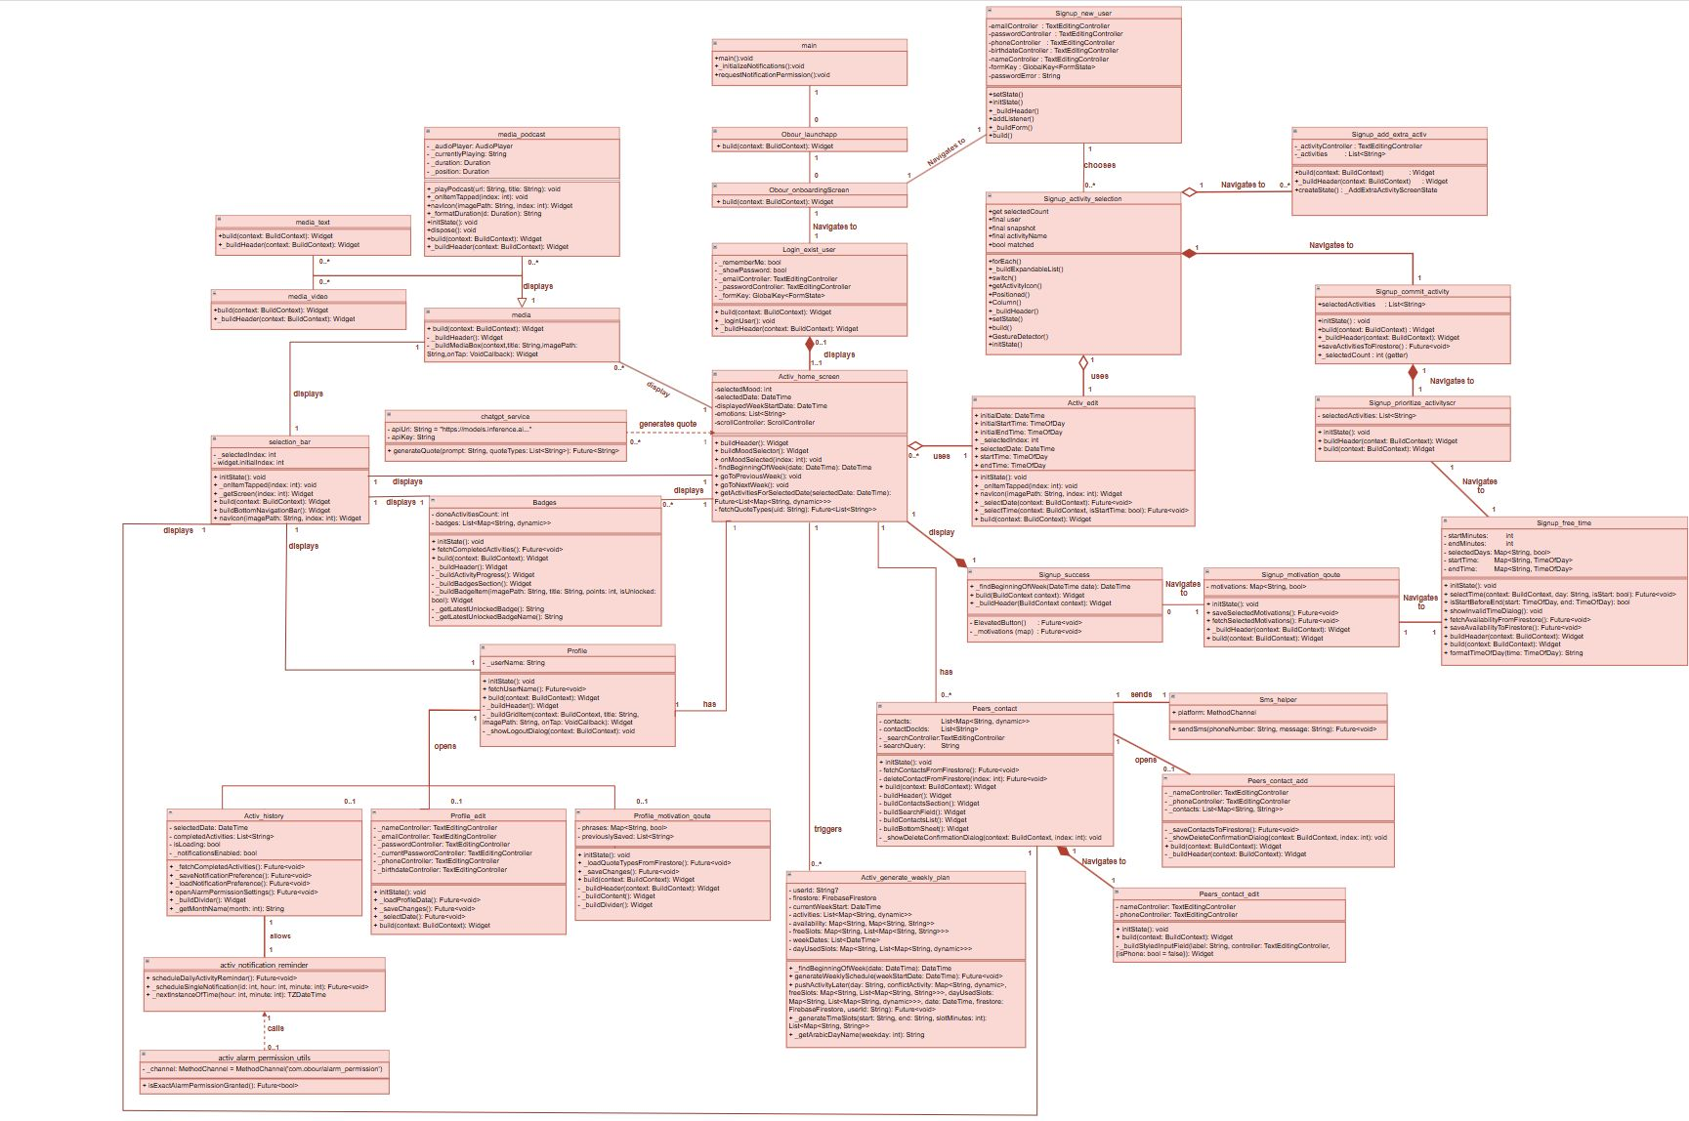
OBOUR
عُبُور
CLASS DIGRAM
ENTIRE UML

Slide 21
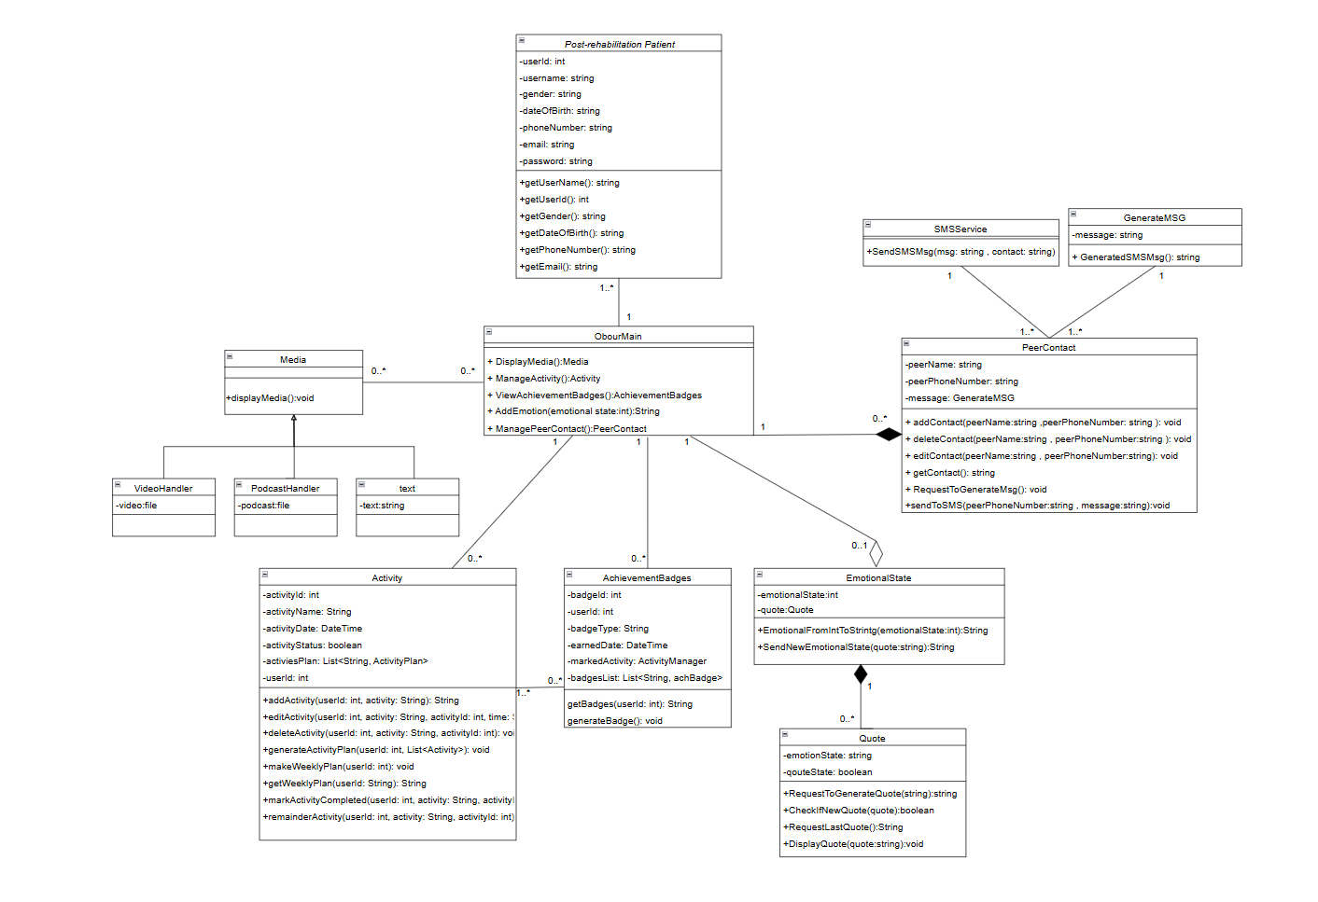
OBOUR
عُبُور
OLD CLASS DIGRAM

Slide 22
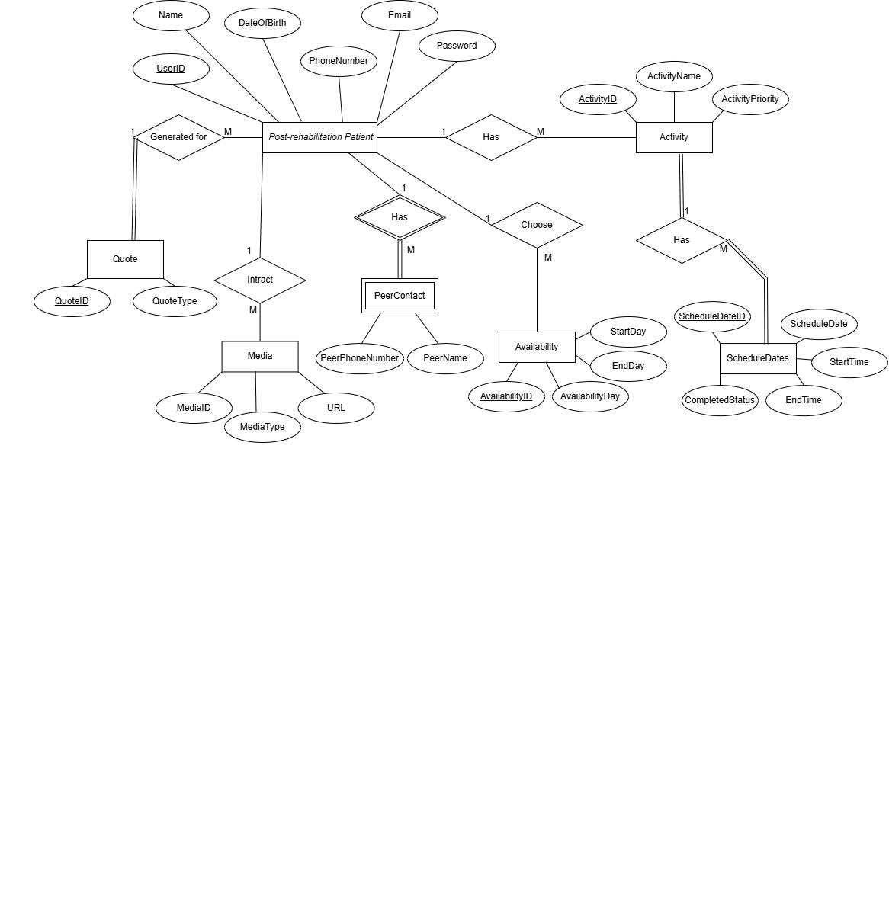
OBOUR
عُبُور
DESIGN OF THE SYSTEM
ENTITY RELATIONSHIP DIGRAM

Slide 23
OBOUR
عُبُور
DESIGN OF THE SYSTEM
CHANGES FROM OLD ER

Slide 24

OBOUR
عُبُور
TESTING

Slide 25
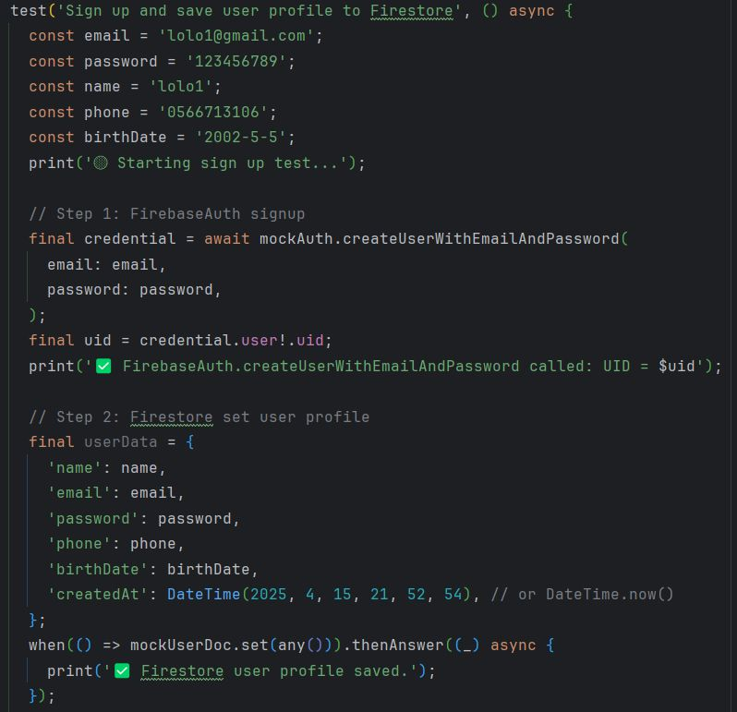
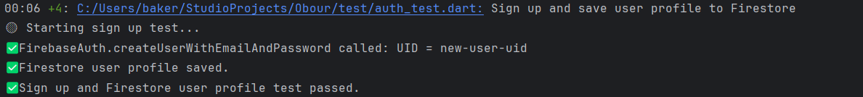
OBOUR
عُبُور
TESTING
UNIT TESTING
SIGNUP TEST
test signup new user and save it to firestore

Slide 26
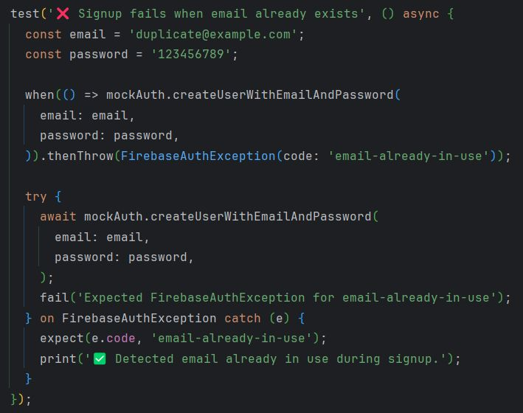
OBOUR
عُبُور
TESTING
UNIT TESTING
SIGNUP TEST
test signup when email already used for another account

Slide 27
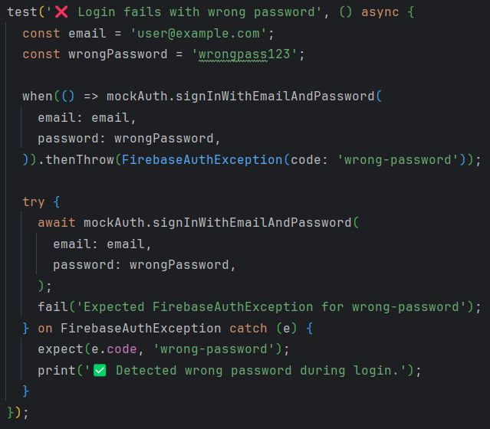
OBOUR
عُبُور
TESTING
UNIT TESTING
LOGIN TEST
test log in when the password is worng

Slide 28
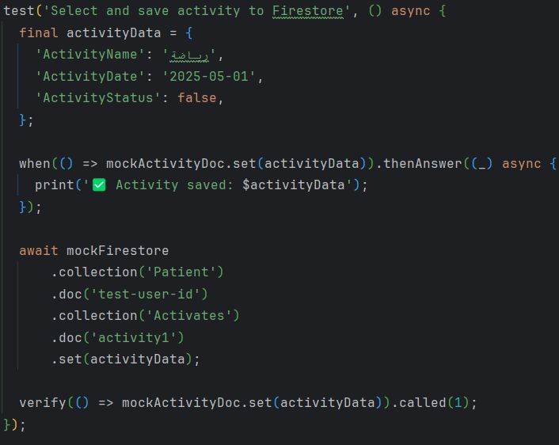
OBOUR
عُبُور
TESTING
UNIT TESTING
ACTIVITY
save activity to firestore

Slide 29
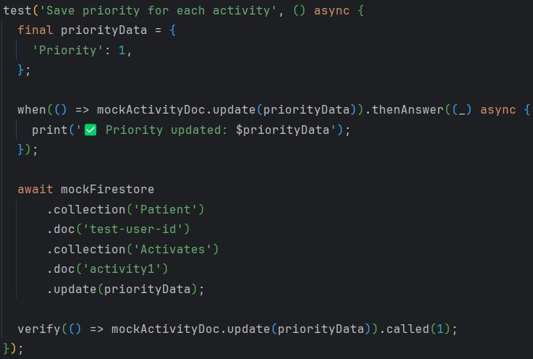
OBOUR
عُبُور
TESTING
UNIT TESTING
ACTIVITY
update priority

Slide 30
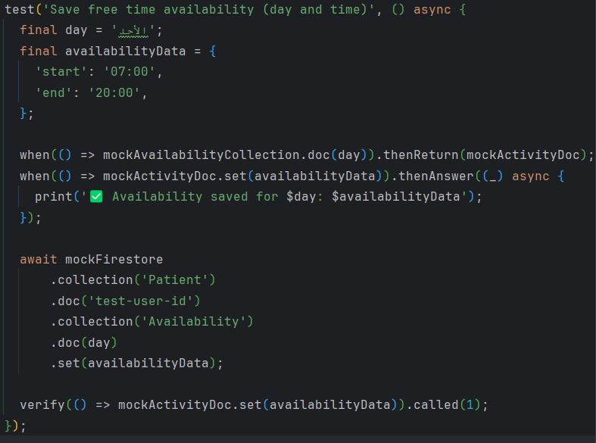
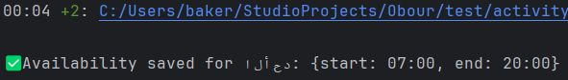
OBOUR
عُبُور
TESTING
UNIT TESTING
AVAILABILITY
add free time “day and time”

Slide 31
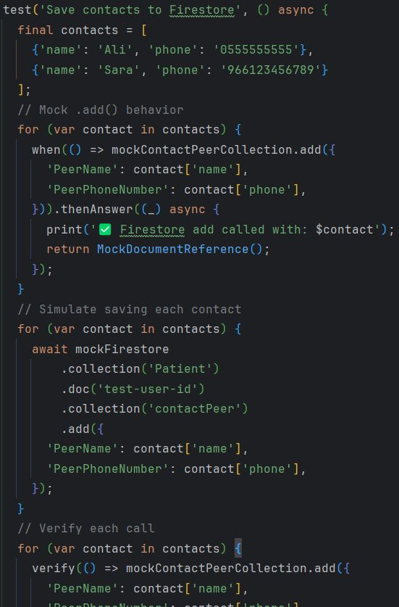
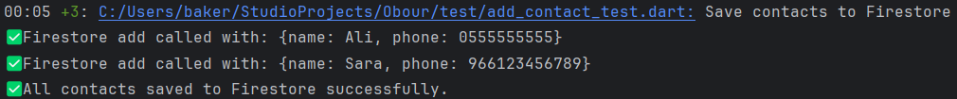
OBOUR
عُبُور
TESTING
UNIT TESTING
PEER CONTACT
add new contact

Slide 32
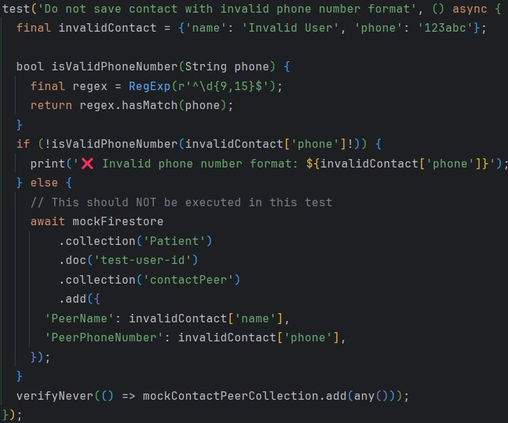
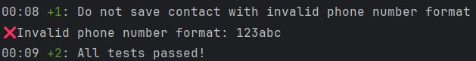
OBOUR
عُبُور
TESTING
UNIT TESTING
PEER CONTACT
add worng phone number when add new contact

Slide 33
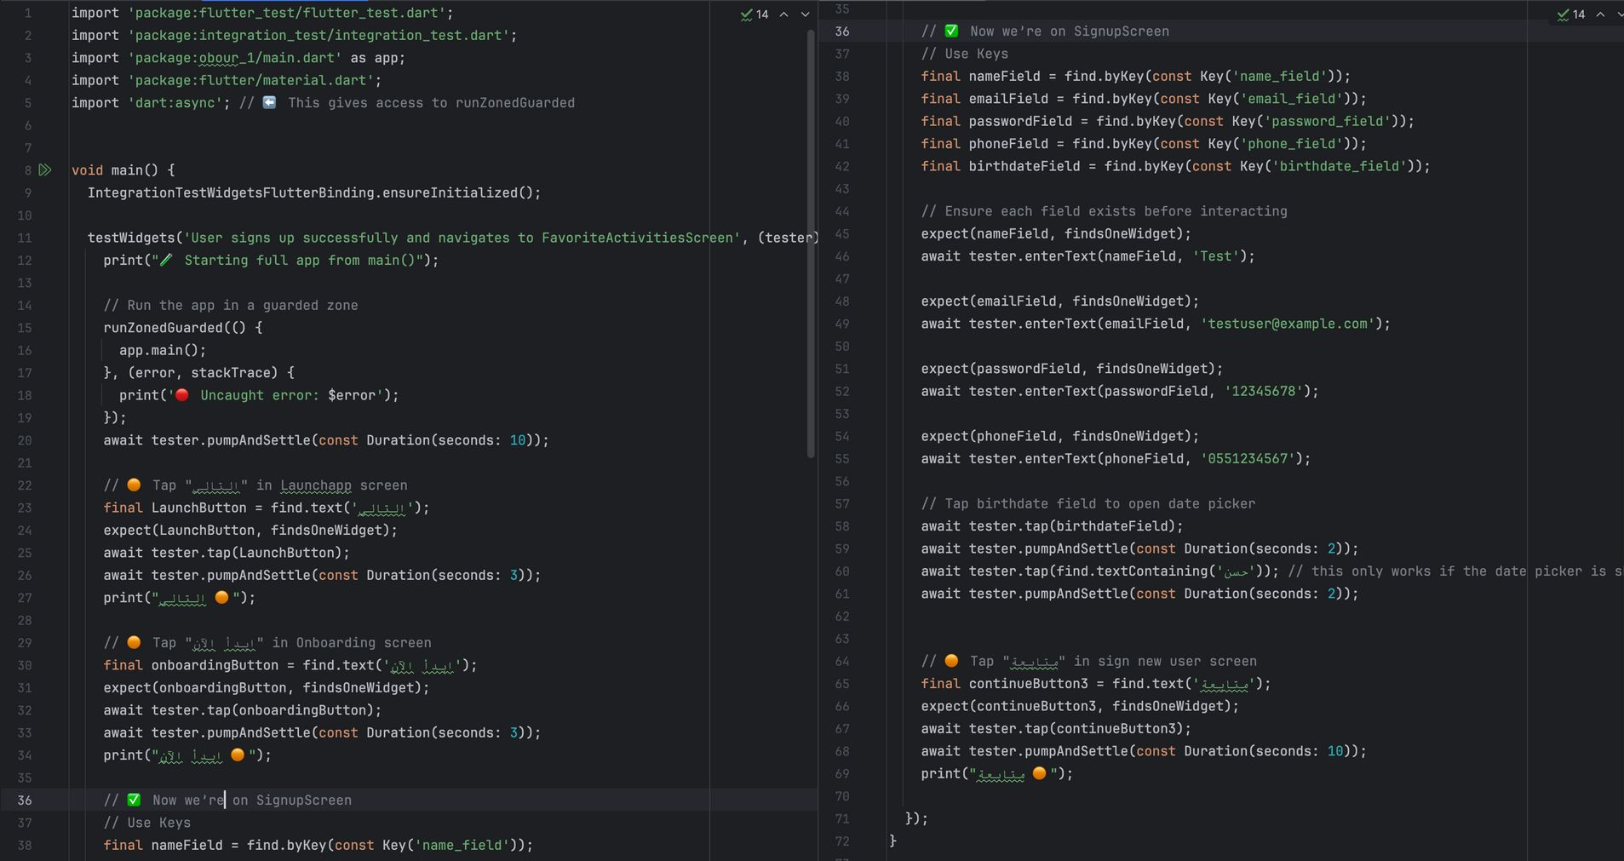
OBOUR
عُبُور
INTGERATION TESTING
TESTING
USER REGISTRATION AND NAVIGATION TEST

Slide 34
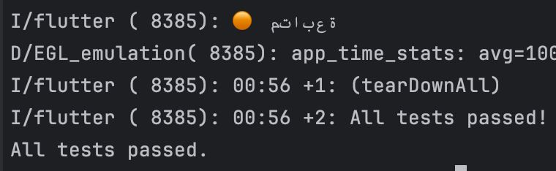
OBOUR
عُبُور
INTGERATION TESTING
TESTING
USER REGISTRATION AND NAVIGATION TEST

Slide 35
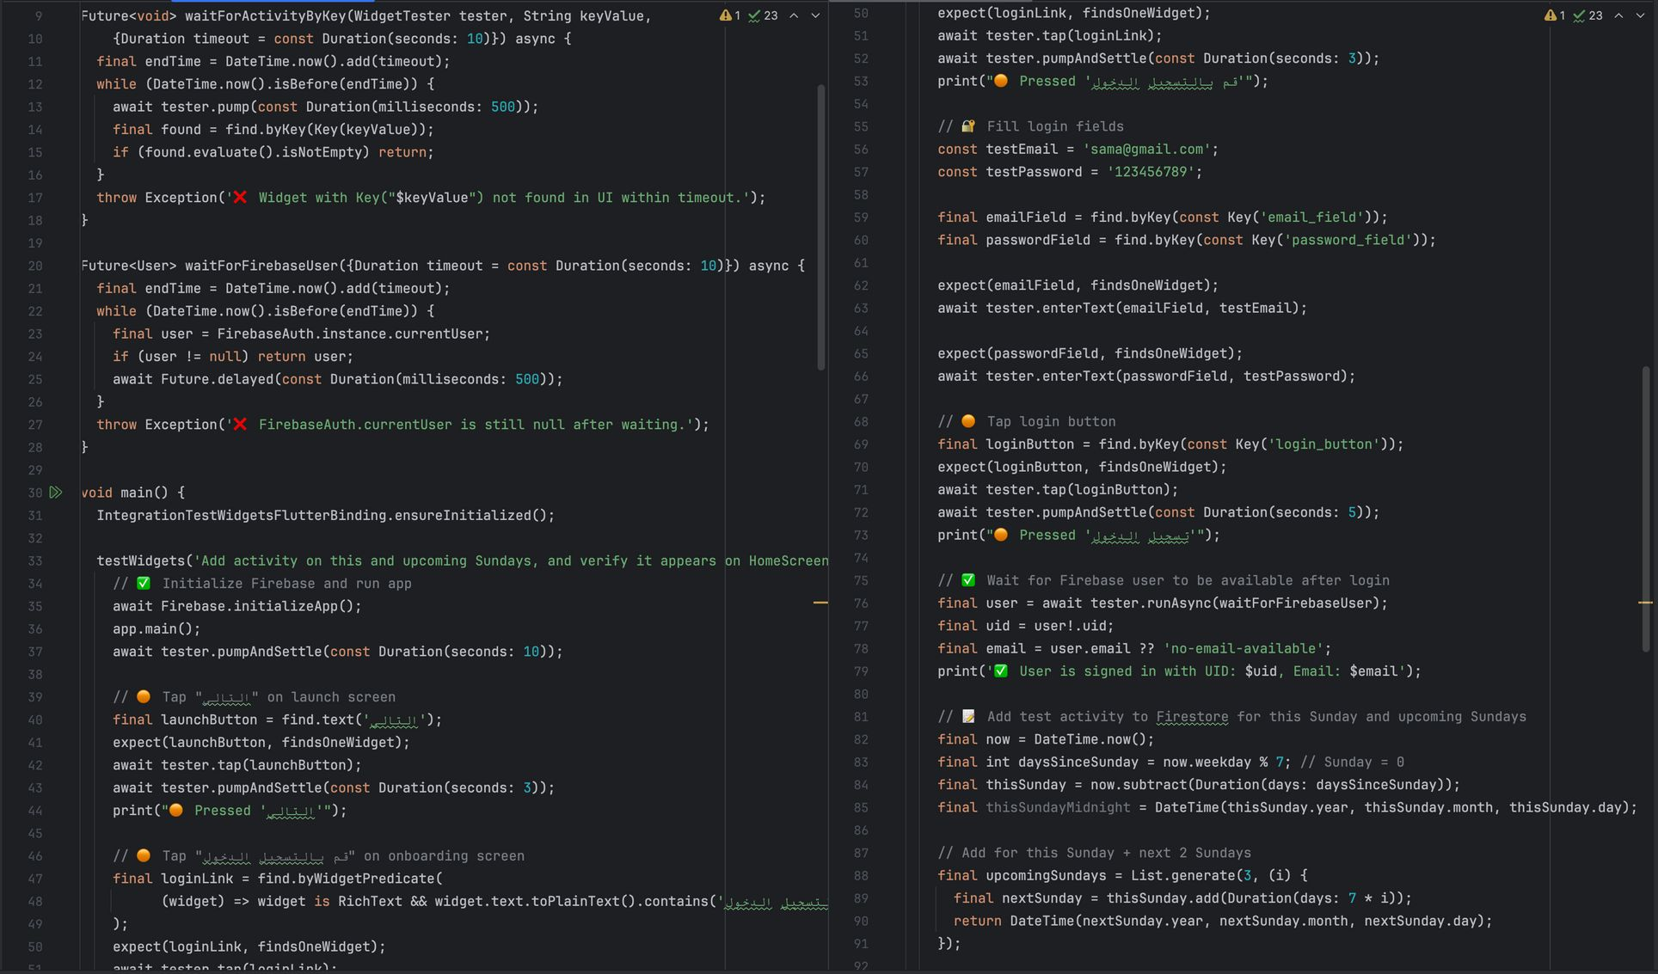
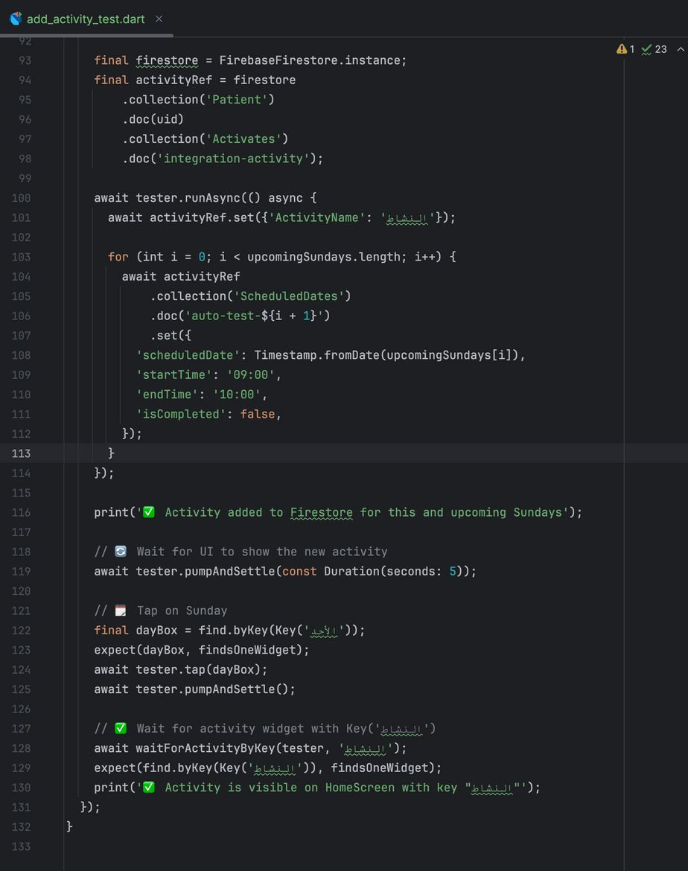
OBOUR
عُبُور
INTGERATION TESTING
TESTING
ADD ACTIVITY TO FIRESTORE AND CONFIRM UI RENDERING

Slide 36
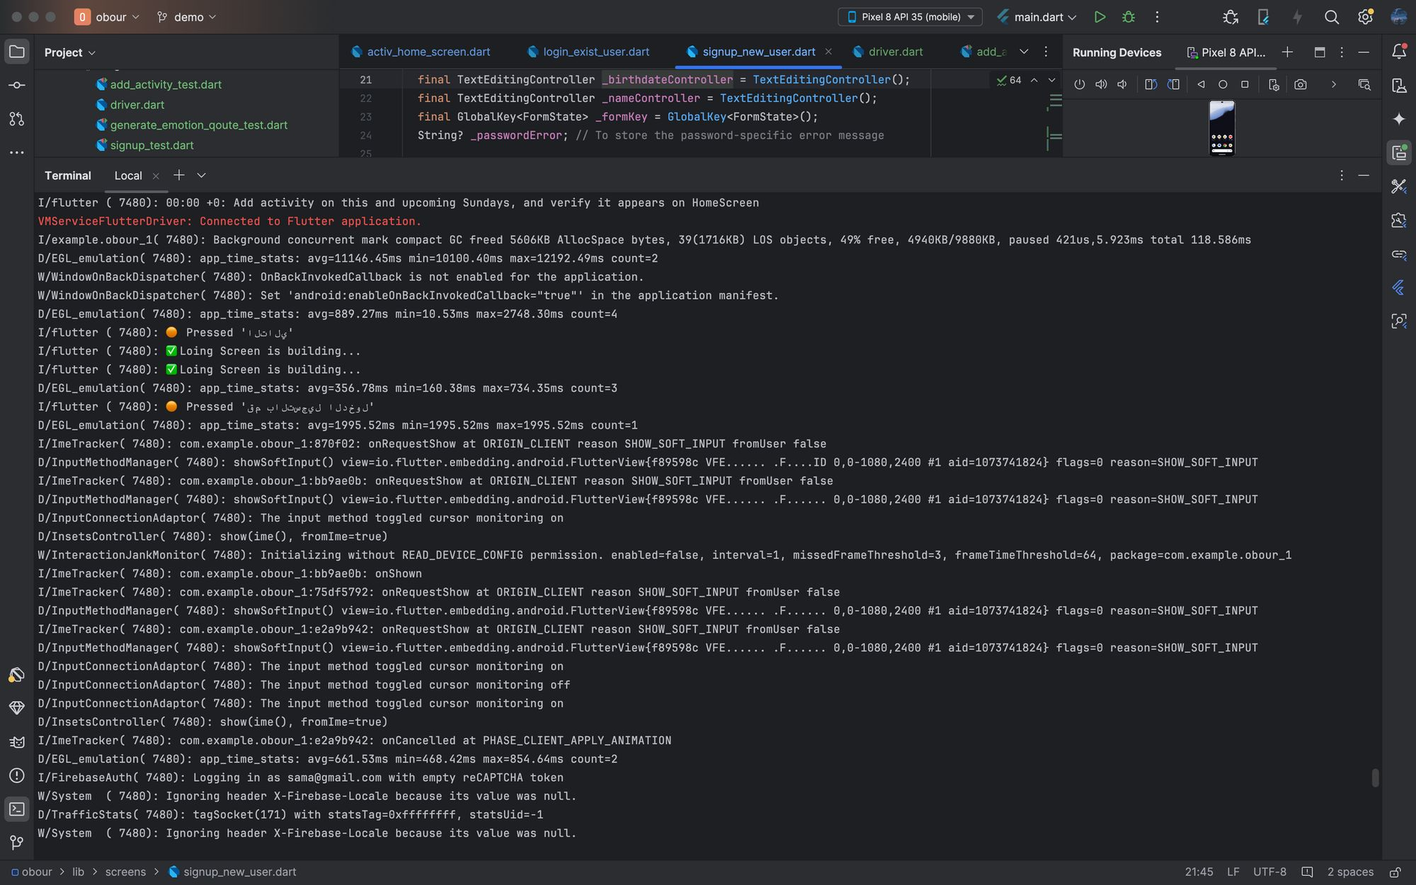
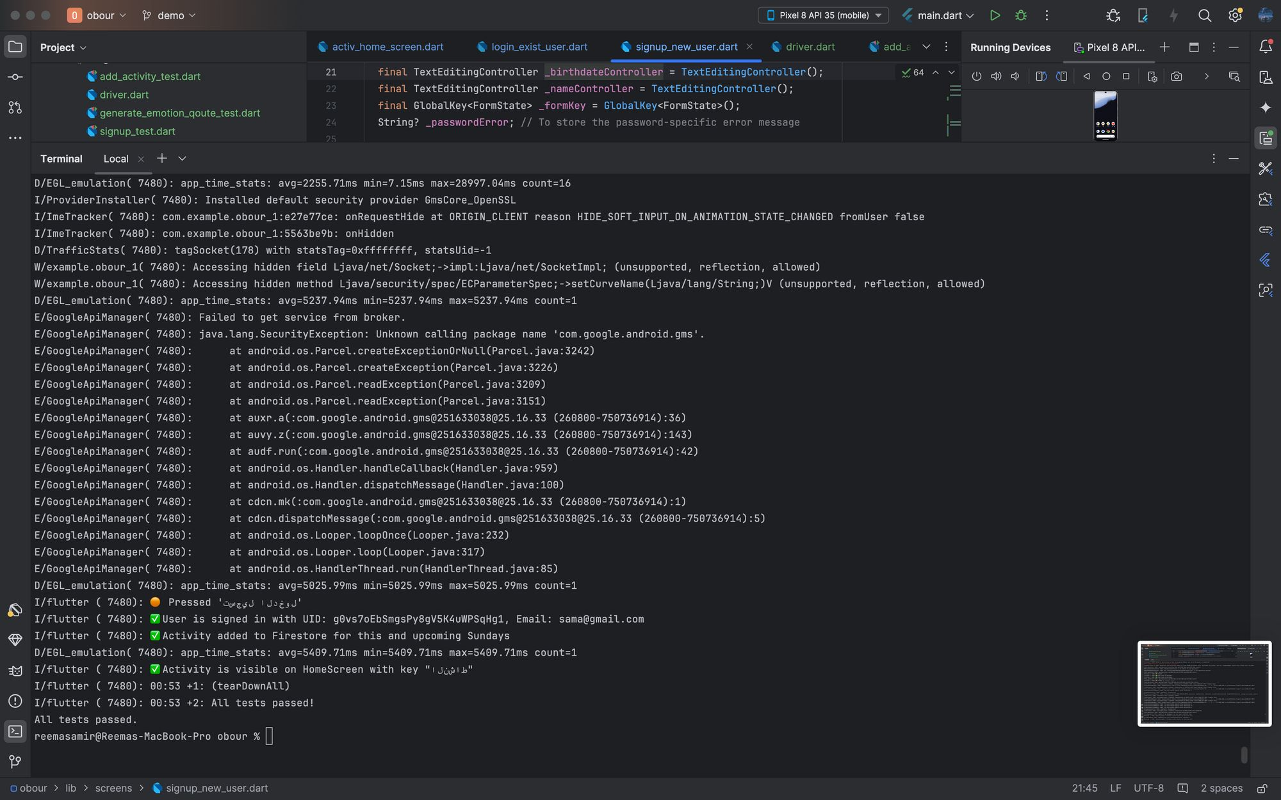
OBOUR
عُبُور
INTGERATION TESTING
TESTING
ADD ACTIVITY TO FIRESTORE AND CONFIRM UI RENDERING

Slide 37
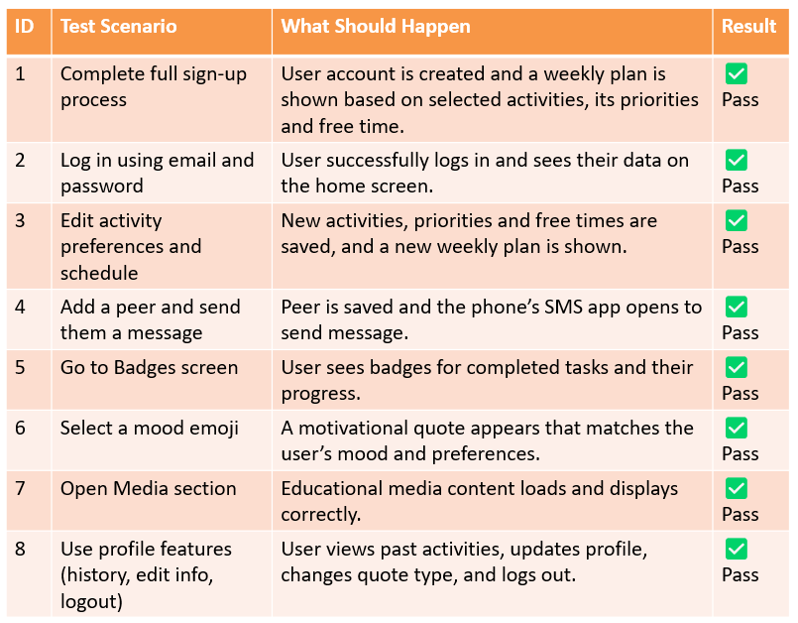
OBOUR
عُبُور
TESTING
SYSTEM TESTING

Slide 38
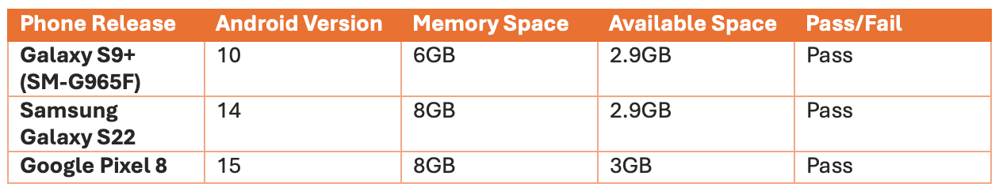
OBOUR
عُبُور
TESTING
COMBATIABLITY TESTING

Slide 39
OBOUR
عُبُور
PROJECT RESULTS

Slide 40
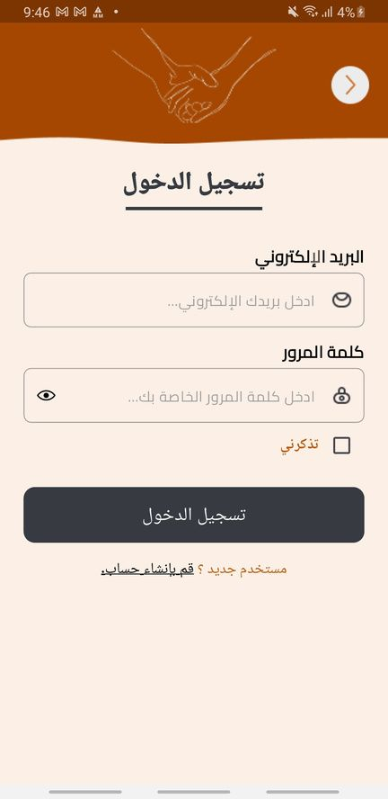
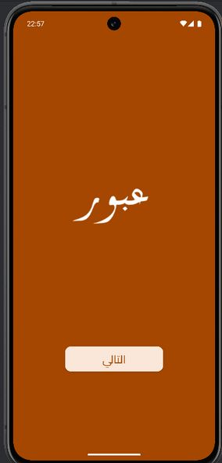
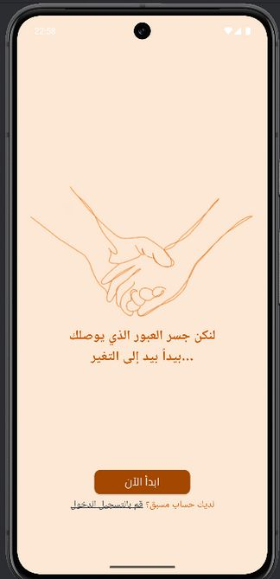
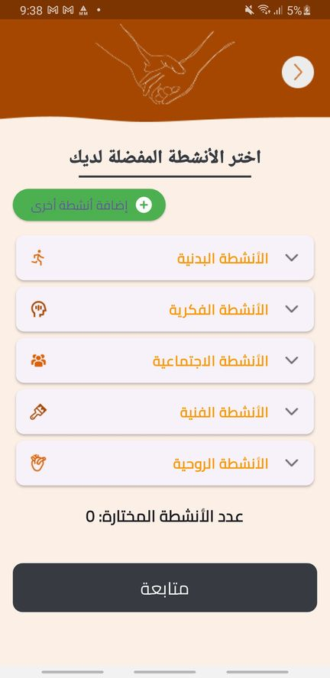
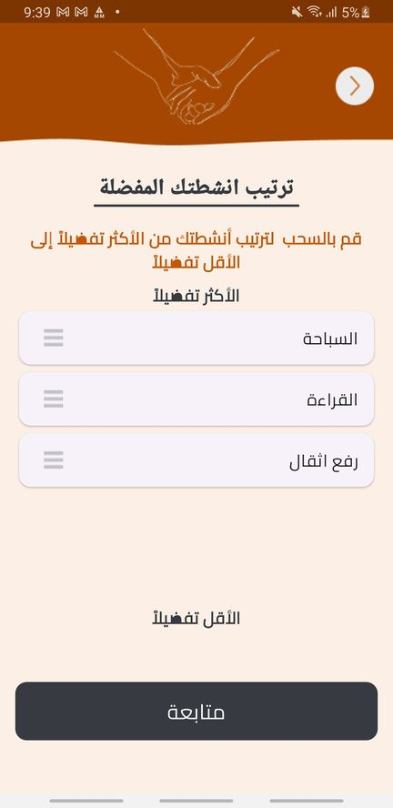
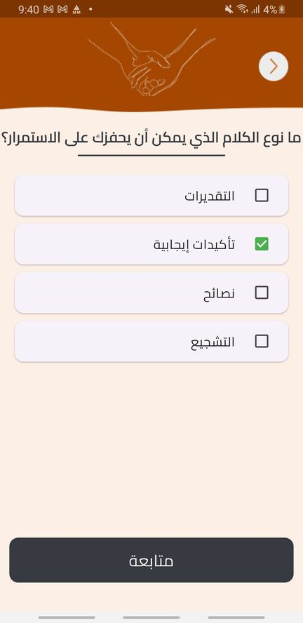
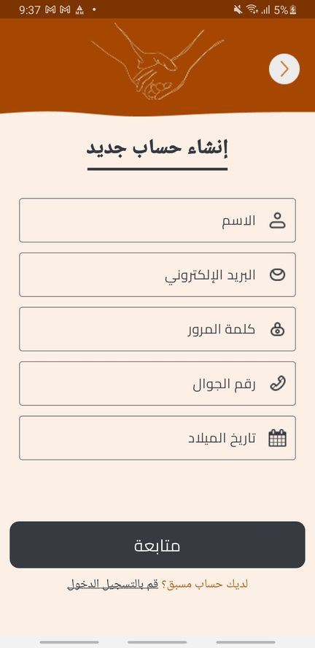
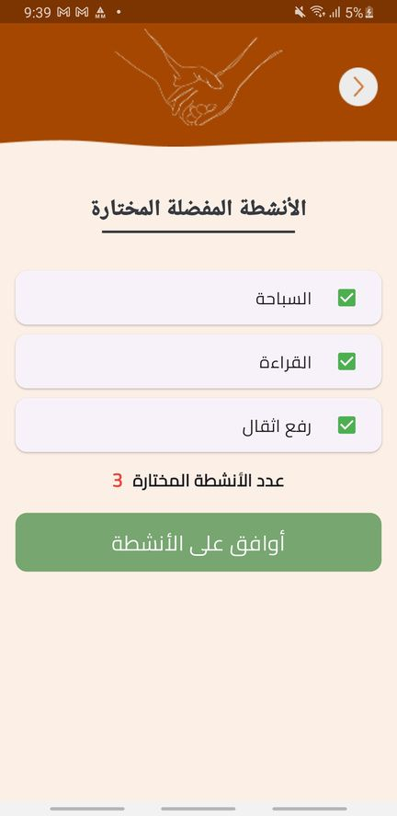
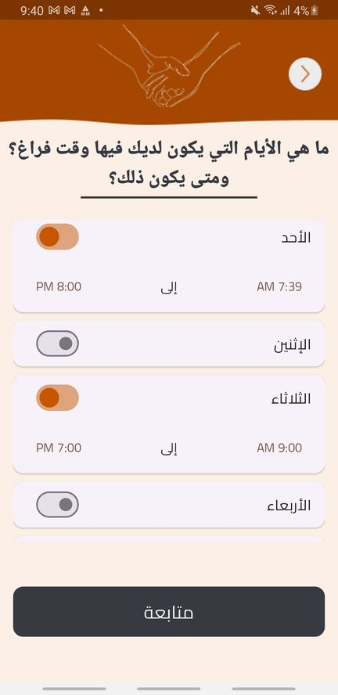
OBOUR
عُبُور
PROJECT RESULTS

Slide 41
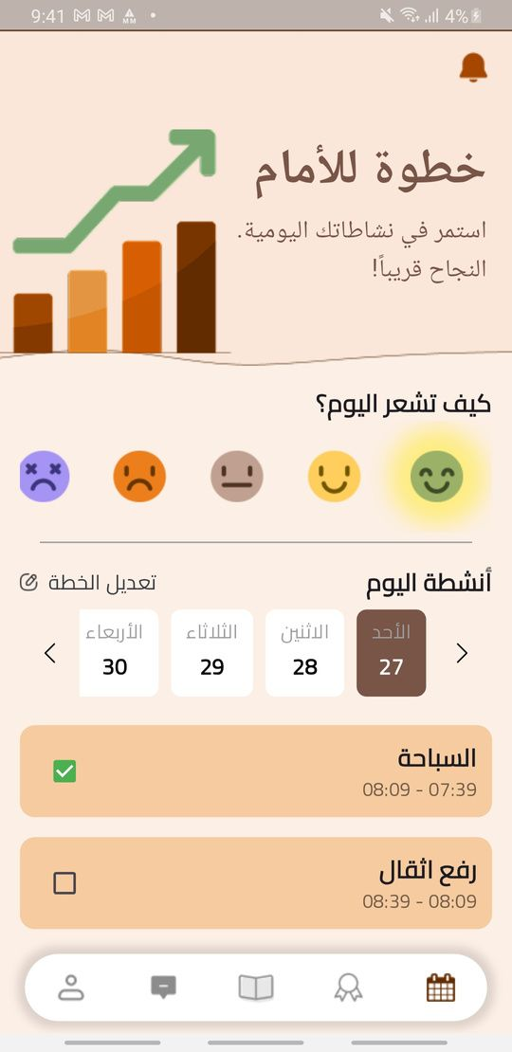
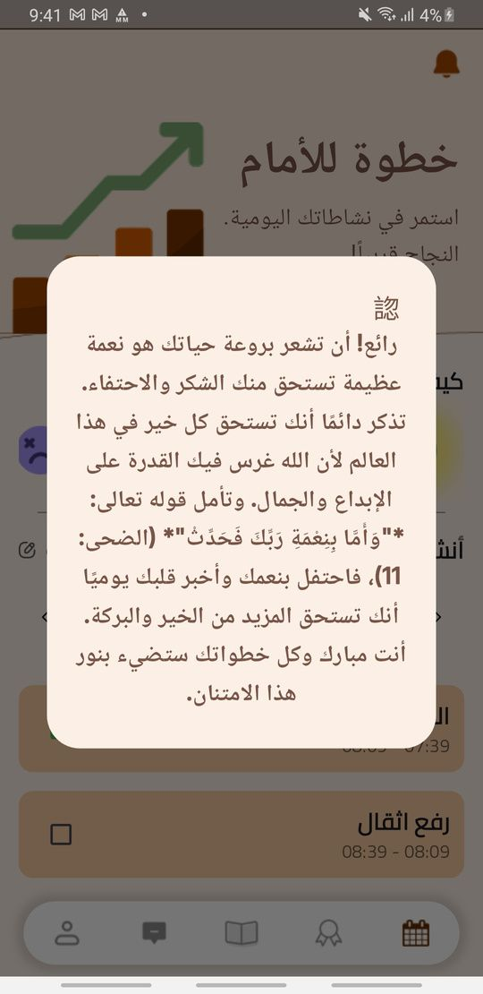


OBOUR
عُبُور
PROJECT RESULTS

Slide 42



OBOUR
عُبُور
PROJECT RESULTS

Slide 43

OBOUR
عُبُور
PROJECT RESULTS
OBOUR DEMO (VIDEO)
SCAN ME!

Slide 44
OBOUR
عُبُور
PROJECT LIMITATION
Firebase Limits: Free plan caused issues with data and testing.
Quote Customization: Hard to combine emotion and user choices.
Activity Scheduling: Difficult to plan tasks based on time and priority.
Notifications: Some reminders didn’t appear as expected.
Data Sync: Activities, contacts, and quotes didn’t always stay updated together.
Testing: Errors while testing Firebase functions.
Git Conflicts: We had problems merging changes and managing code versions.

Slide 45

OBOUR
عُبُور
FUTURE WORK
Using AI to diagnose and scale the severity of drug use-related issues can enhance treatment precision and improve recovery progress
Using AI to create personalized activity plans for patients based on their interests can boost engagement and foster sustained rehabilitation
Involving doctors in ongoing patient care through regular medical follow-ups to support effective treatment and recovery.

Slide 46

OBOUR
عُبُور
CONCLUSION

Slide 47
OBOUR
عُبُور
THANK YOU!
Do you have any questions?

